Slide 1




Business Management for IT
(IT3090)
Basics of Management
(Lesson 2)

Slide 2
Outline
Definition of management
Functions of Management
Leadership
Motivation
Team Management

Slide 3
Management Defined…
The attainment of organisational goals in an effective and efficient manner through planning, organizing, leading and controlling organizational resources (Daft, 2012).
Management is the process of planning, organizing, leading and controlling the efforts of organization members and of using all other organizational resources to achieve organizational goals (Stoner and Freeman,2009).

Slide 4
What Is Management? (Cont’d…)
Applies to and through any kind of organization
Applies to Managers at all levels
Concerned with “Doing the right things right at all times”:
Effectiveness: Achievement of objectives. (Right Things); Attaining organizational goals
  Efficiency: Achieving those objectives with least amount/ sacrifice of resources.(Things Right); Getting the most output for the least inputs

Slide 5
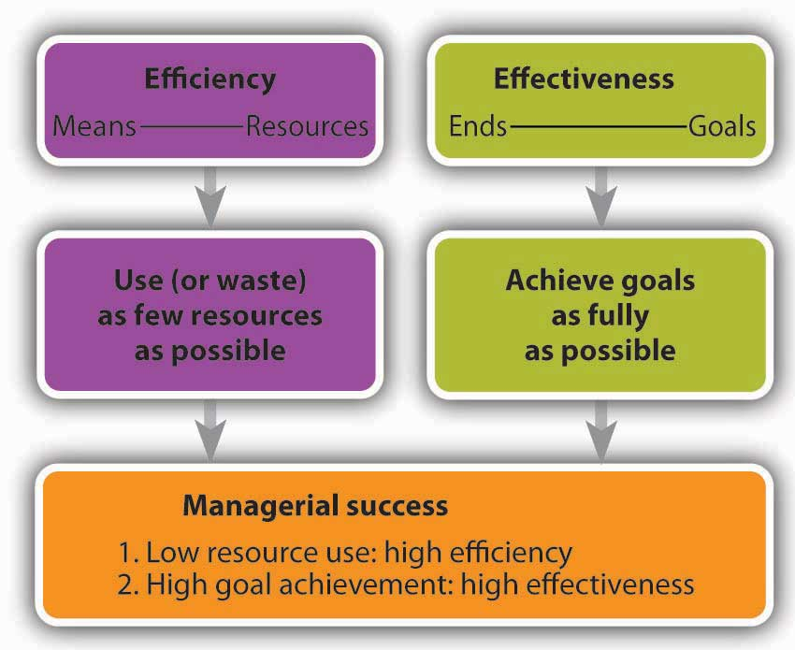
Effectiveness and Efficiency

Slide 6
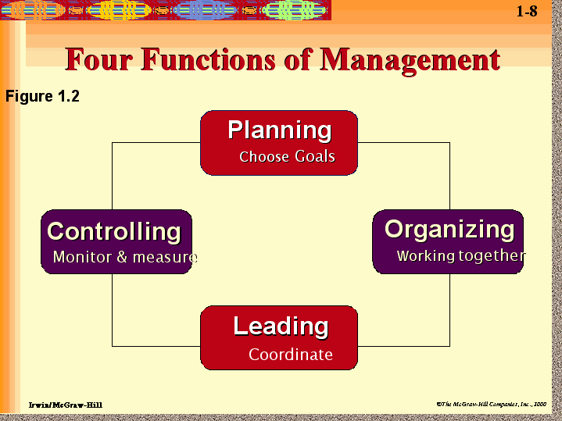
Management Functions

Slide 7

Planning
Management Functions

Slide 8
Planning :Setting organizational goals and how best to achieve it
Planning act as a guidance for future
e.g
What is the sales target for next year ?
When will be the next product launch?
Should we open a new branch? When? How?

Slide 9
Hierarchy of Aims
Vision
Mission
Goals
Corporate Objectives
Tactical Objectives
Operational Objectives
Decide where the organisation should be in X years of time

Slide 10
What is a “Vision” ?
Vision is the all inclusive general goal towards which the entire organisational efforts and resources are directed.
It is the vivid aspiration or the ultimate aim that the entire organisation hopes to realize in the very long future.
Vision describe in vague terms what the type of organization it wishes to build in the very long future.
BM 102 Principals of Management

Slide 11
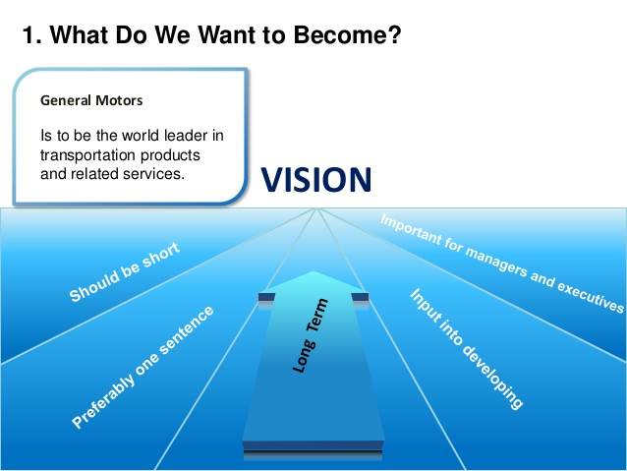

Slide 12


"All Sri Lankans seamlessly connected with world-class information, communication and entertainment services."
Vision – Sri Lanka Telecom

Slide 13
What is a “Mission” ?
Definition of a business in its scope and philosophy
The fundamental, unique purpose that sets a business apart from other firms of its types and identifies the scope of its operations in product and market terms.
BM 102 Principals of Management

Slide 14
Mission – Sri Lanka Telecom
"Your trusted and proven partner for innovative and exciting communication experiences delivered with passion, quality and commitment"

Slide 15

Goal
General statements of future aims which represent the main core areas of the mission of an organization.
BM 102 Principals of Management

Slide 16
Objectives
What is intended to achieve within a defined medium to short period of time
Expected measurable end results or aims of action
BM 102 Principals of Management

Slide 17
Characteristics of Objectives
Specific
Measurable
Achievable
Rational/Related
Time Bound
Objectives should be SMART
BM 102 Principals of Management

Slide 18
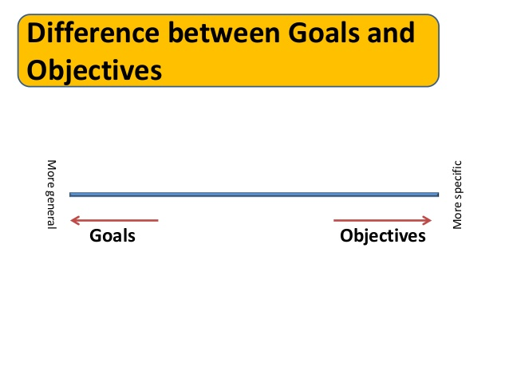

Slide 19

Organizing
Management Functions

Slide 20
Organizing is coordinating activities and resources
Organize people and other resources necessary to carry out the set goals
Tasks, jobs, positions, duties and responsibilities can be summarized in to the organizational structure
  e.g.
How many employees needed to achieve the expected sales target?
Who will be responsible to carry out promotions?
How much funds required for advertising campaign?
BM 102 Principals of Management

Slide 21

Leading
Management Functions

Slide 22
Leading is simply motivating and managing people of the organization to achieve allocated tasks and responsibilities finally leading to achieve goals.
e.g.
How the manager can make employees work hard, with good team spirit?
How the manager can encourage a sales person who failed to achieve given targets?

Slide 23


Leadership

Slide 24
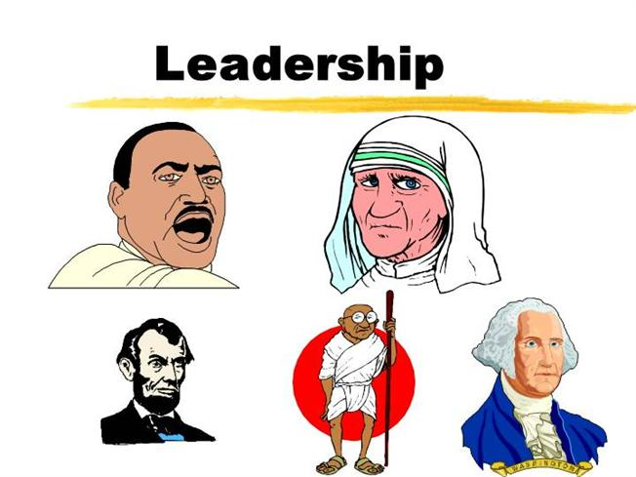
Definition Leading/ Leadership
Leader is a person who can influence others and who has managerial authority (Stephen P. Robbins).
Leadership is the process of influencing a group towards the achievement of goals(Stephen P. Robbins,).

Slide 25

Leadership Theories
Trait Theory
Behavioral Theory
Charismatic leadership

Slide 26
Trait Theory
“Leaders are born rather than made.”
People are born with inherited traits.
Some traits are particularly suited to leadership
People who make good leaders have the right combination of traits.

Slide 27
Behavioral Theories
Leaders can be made, rather than born
Behavioral theory researchers tried to determine what effective leaders do –
  how they delegate tasks
  how they communicate with and try to motivate their followers or employees
  how they carryout their tasks

Slide 28
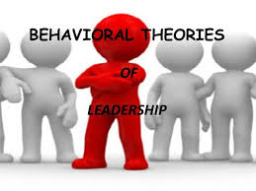
Behavioral Theories
  Kurt Lewin - Concentrated on three leadership styles.
  Autocratic
  Participative
  Laissez – faire

Slide 29
Behavioral Theories – Kurt Lewin
  The autocratic Leader
  tends to make decisions without involving subordinates.
  spells out work methods
  sometimes give negative feedback
  The participative Leader
  Includes the group in decision making
  Consults the subordinates on proposed actions and encourage participation from them.
  let the group determine work methods
  use feedback to help subordinates
Notes:
Laissez – faire
decision making is when the leader gives up ownership and control of a decision and allows the group to vote. Majority vote will decide the action. Advantages include a fairly fast decision, and a certain amount of group participation. The disadvantage of this style includes no responsibility. An individual is not responsible for the outcome. In fact, even the group feels no real responsibility because some members will say, "I didn't vote for that.". Lack of group and personal responsibility seems to disqualify this style of decision making; however, the democratic style does have its place in business.
Autocratic decision making is when the leader maintains total control and ownership of the decision. The leader is also completely responsible for the good or bad outcome as a result of the decision. The leader does not ask for any suggestions or ideas from outside sources and decides from his or her own internal information and perception of the situation. Advantages include a very fast decision, and personal responsibility by the leader, for the outcome. If an emergency situation exists, the autocratic style is usually the best choice. The disadvantages are varied and sometimes include less than desired effort from the people that must carry out the decision. If the employee is personally affected by the decision but not included when the decision is made, morale and effort may or may not suffer. It is not always predictable. If the outcome for the decision is not positive, members of the organization begin to feel they could have done a better job themselves and the leader may lose credibility.
Collective - Participative decision making is when the leader involves the members of the organization. Other perspectives of the situation are discovered because the leader deliberately asks and encourages others to participate by giving their ideas, perceptions, knowledge, and information concerning the decision. The leader maintains total control of the decision because, although outside information is considered, the leader alone decides. The leader is also completely responsible for the good or bad outcome as a result of the decision. The advantages include some group participation and involvement. This is especially valuable when a person is affected negatively by the decision. In most cases, the individual is informed before the decision is implemented (no surprises) and usually feels good about personal involvement. If the leader is a good communicator, and listens carefully to the information collected, he or she will usually have a more accurate understanding of the situation and make a better decision. The disadvantages of this style include a fairly slow, time consuming decision; less security, because so many people are involved in the decision.

Slide 30
Behavioral Theories – Kurt Lewin
Laissez faire Leaders
  Use their power very rarely
  Give the group complete freedom
  Allows subordinates to set their goals and the means for achieving them
  Avoid giving feedback
Notes:
Leadership styles and their effects
With colleagues L. Lippitt and R. White, Lewin carried out studies relating to the effects of three different leadership styles on outcomes of boys' activity groups in Iowa (1939). Three different styles were classified as democratic, autocratic, and laissez-faire. It was found that in the group with an autocratic leader, there was more dissatisfaction and behaviours became either more aggressive or apathetic. In the group with a democratic leader, there was more co-operation and enjoyment, while those in the laissez-faire led group showed no particular dissatisfaction, though they were not particularly productive either.

Slide 31

Charismatic Leadership
  Form of international attraction that inspires support and acceptance
  An enthusiastic, self-confident leader whose personality and actions influence people to behave in certain ways.

Slide 32
Charismatic Leader
Characteristics:
  Have a compelling vision
  Ability to articulate that vision
  Demonstrate consistency and focus
  Know their strengths and capitalize on them
  Strong self confidence and make others also confident

Slide 33
Motivation

Slide 34

Motivation & Human needs
Needs and wants are always related with motivation
A rational person always seek to satisfy one or more of their needs
So they try to find a way to satisfy their need.
Recruitment & Selection
Motivation

Slide 35
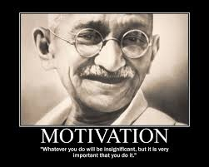
Motivation Defined
The driving force within individuals by which they attempt to achieve a goal in order to fulfill some need or expectation.
Recruitment & Selection
Motivation

Slide 36
Maslow’s Hierarchy of Needs
Maslow presented his theory based on certain assumptions:
Individuals are perpetually(forever, continuously) wanting animals.
Only unsatisfied needs are capable of motivating behavior.
Five levels of needs could be arranged in a hierarchy.
Once the lower level needs are been satisfied , individuals will be motivated to achieve higher level of needs.
Motivation

Slide 37
Maslow’s Hierarchy of Needs
Hierarchy of Needs Theory
(Abraham Maslow)
NEEDS
General Examples
Organizational Examples
Self-
actualization
Challenging
job
Achievement
Status
Esteem
Job
title
Friendship
Belongingness
Friends
at work
Stability
Security
Pension
plan
Food
Physiology
Base
salary
Motivation

Slide 38
Team Management

Slide 39


Stages of Team Development
Forming Stage
Storming Stage
Norming Stage
Performing Stage

Slide 40

Stages of Team Development
Forming Stage : Building awareness
People act in a formal manner (anxious)
Feelings and weaknesses covered up
No shared understanding for task
Some insensitive to others views
Some Concerns:
Senior staff (Leaders) taking control

Slide 41
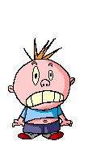
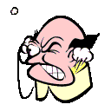
Stages of Team Development
Storming Stage: Conflicts, disagreements, resistance
Personal issues become apparent
(3 psychologies – Critical Parent, Child, Adult)
Concern for other members views, values
Ineffective confrontation
Dissatisfaction
Some Concerns:
Team too disjoined to reach the next stage
Just acting out the roles, no real involvement

Slide 42

Stages of Team Development
Norming Stage: Settling down having reached common
understanding, cooperation, collaboration
Confidence and trust grows
Systematic and open approach develops
Consider other options and valuing of others skills
Clarification of purpose and objectives
Prepare plans and measure progress

Slide 43

Stages of Team Development
Performing Stage: Reaching team goals
Focused
Everyone is involved
Flexibility ( no resistance )
Leadership is given relevant to task

Slide 44

Controlling
Management Functions

Slide 45
Management Functions –Controlling
Controlling is monitoring the organizational progress toward its goals.
Managers need to ensure that the people functions/perform in a manner to achieve set goals.
e.g.
Have the sales person achieved the targets?
If not why? What are the reasons for the deviations ? What are the corrective actions required?

Slide 46




References

